Slide 1
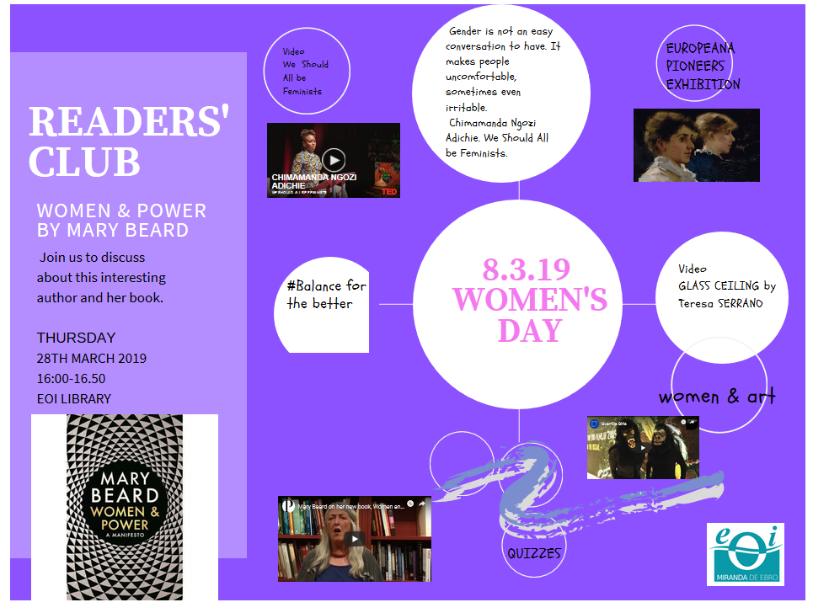
Europeana Pioneers Exhibition
We should al be feminists
Balance for the better
Glass ceiling by Teresa Serrano
Mary Beard on her new book Women and Power
Guerrilla Girls
Women’s Day Quiz

